Slide 1
UNDERSTANDING NUTRITION
Chapter 5: Carbohydrates (CHO)

Slide 2
WHAT ARE THEY?
Major source of energy for the body
Include both starches and sugars
Grouped into simple or complex forms

Slide 3
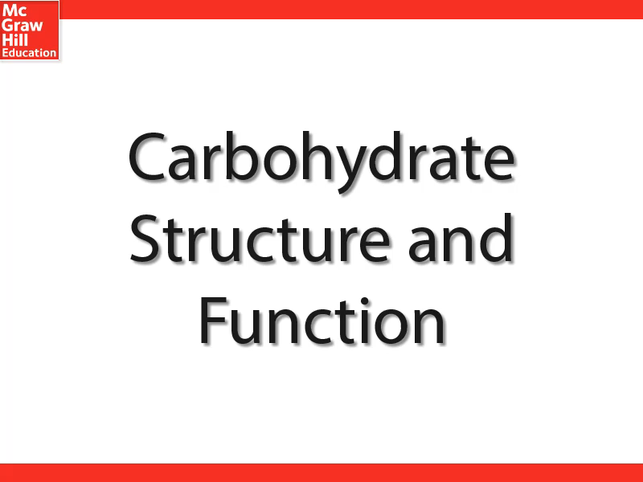

Slide 4
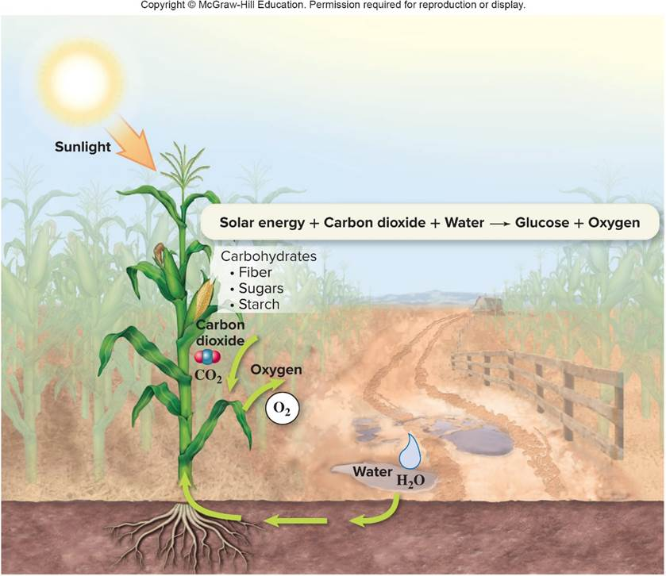
PLANTS MAKE CARBOHYDRATES
Plants use the sun’s energy to combine carbon, oxygen, and hydrogen atoms to make carbohydrate (glucose).

Slide 5
SUGARS
The simplest form of carbohydrate is a sugar.
The simplest sugar is a monosaccharide – it is the basic chemical unit of carbohydrates.
A disaccharide is a sugar comprised of two monosaccharides.

Slide 6
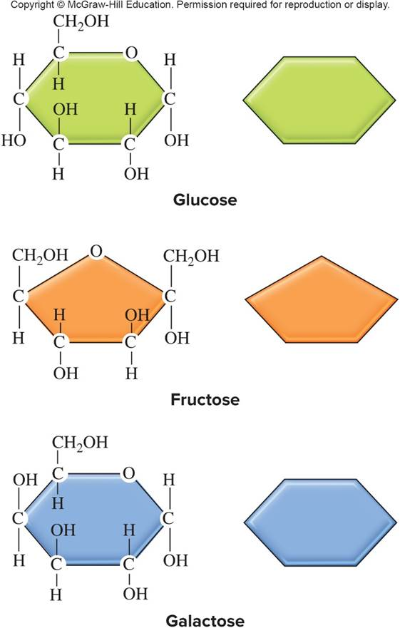
MONOSACCHARIDES
Glucose
Primary energy source for cells
Also referred to as “dextrose” or “blood sugar”
Fructose
“Fruit sugar” or “levulose”
Galactose
Part of “milk sugar” (lactose)

Slide 7
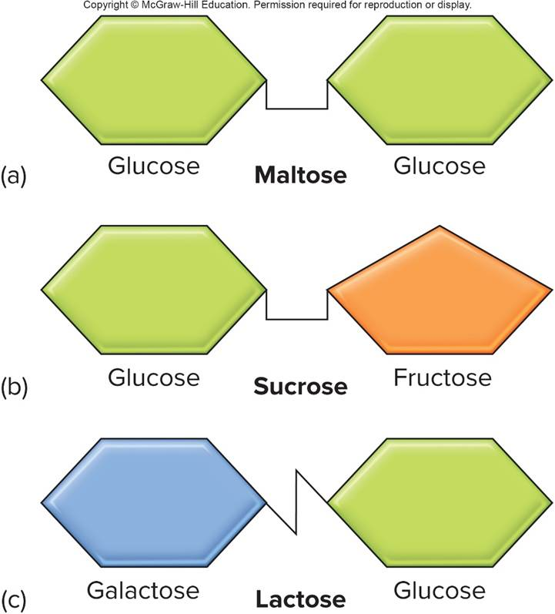
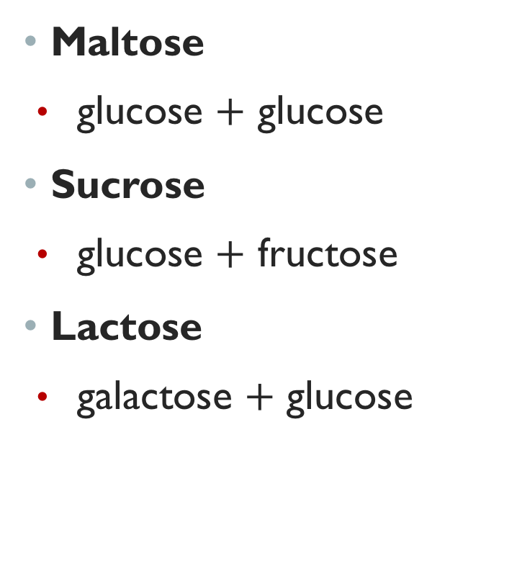
DISACCHARIDES

Slide 8
SUCROSE
Table sugar (sucrose)
Made from refining sugar cane or sugar beets
Refinement strips away small amounts of vitamins and minerals naturally present in cane & beets.
A tablespoon of table sugar is almost 100% sucrose.
Occurs naturally in honey, maple syrup, carrots, and sweet fruits such as pineapples.

Slide 9
NUTRITIVE SWEETENERS
Nutritive sweeteners
Contribute energy to foods
Provide 4 kcal/g
Added sugars
Nutritive sweeteners added during processing or preparation
e.g., sucrose and high-fructose corn syrup

Slide 10
ALTERNATIVE NUTRITIVE SWEETENERS
Added to a food to sweeten it but provide fewer kilocalories than sugars.
Substitutes for sugars in foods and some other items such as “sugar-free” chewing gum
What are sugar alcohols?
Alternative nutritive sweeteners:
Sorbitol, xylitol, and mannitol
Poorly absorbed and may cause diarrhea
Supply 2 kcal/g
Do not contribute to dental cavities.

Slide 11
NONNUTRITIVE SWEETENERS1
Synthetic compounds that sweeten foods while providing little or no kilocalories
High-intensity sweeteners are extremely sweet compared to the same amount of sucrose.

Slide 12
POLYSACCHARIDES (COMPLEX CARBOHYDRATES)
Polysaccharides are complex carbohydrates.
Contain >10 monosaccharides bonded together
Storage form of energy in plants and animals
Structural component in the stems and leaves of plants
Common dietary polysaccharides contain hundreds of glucose molecules
Some of these polysaccharides are not digestible by humans.

Slide 13
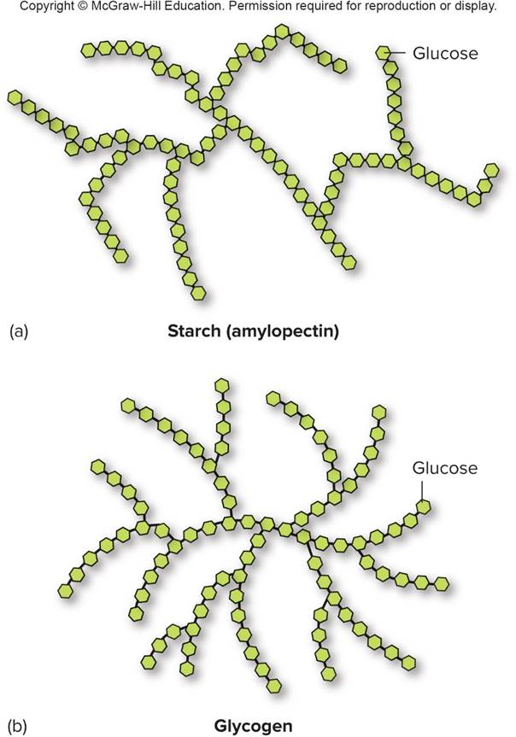
STARCH AND GLYCOGEN
Starch
Storage form of carbohydrate (glucose) in plants
Mainly in seeds, roots
Glycogen
Storage form of carbohydrate (glucose) in humans and other animals
Stored primarily in liver and muscles

Slide 14
DIETARY FIBER (“FIBER”)
Most forms of dietary fiber are complex carbohydrates that humans cannot digest.
Two types: Insoluble and soluble
Insoluble forms include:
Cellulose, hemicelluloses
Soluble forms include:
Pectins, gums, mucilages, and some hemicelluloses

Slide 15


Slide 16
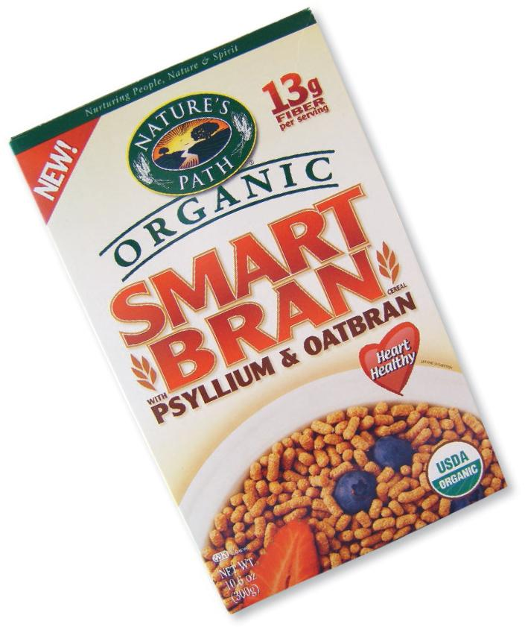
WHAT’S A WHOLE GRAIN?
The intact, ground, cracked, or flaked seeds of cereal grains
To be labeled “whole grain,” the food must contain:
Fiber-rich bran
Starchy endosperm
Oily germ

Slide 17
FIBER AND HEALTH
Fiber and the Digestive Tract
Some forms of fiber swell in large intestine
Softer stools and more regular bowel movements
May help prevent or relieve constipation
High-fiber diet may reduce risks of
Obesity
Type 2 diabetes
Certain intestinal tract disorders
Heart disease and stroke

Slide 18
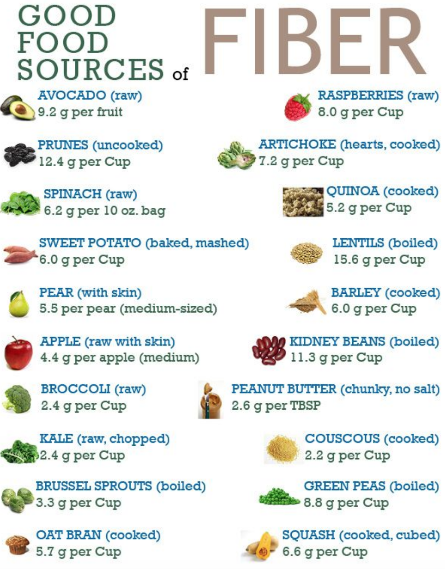

Slide 19
CARBOHYDRATE DIGESTION, ABSORPTION, AND ELIMINATION
Mouth — salivary amylase digests some starch
Stomach — acid inactivates salivary amylase
Small intestine — main site for carbohydrate digestion and absorption
Pancreatic amylase
Maltase
Sucrase
Lactase

Slide 20
Liver — receives absorbed glucose, fructose, and galactose from the small intestine
Large Intestine — some soluble fiber and undigested carbohydrates are fermented
Rectum — very little dietary carbohydrate eliminated in feces

Slide 21
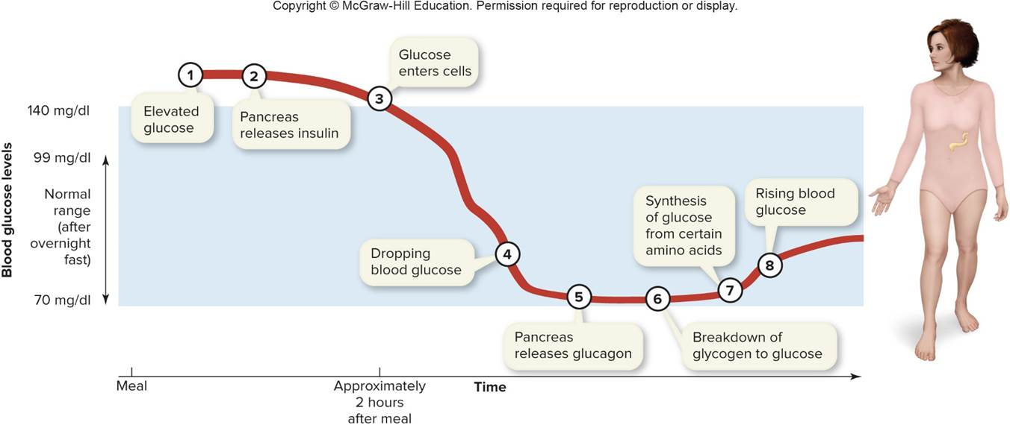
MAINTAINING BLOOD GLUCOSE LEVELS

Slide 22
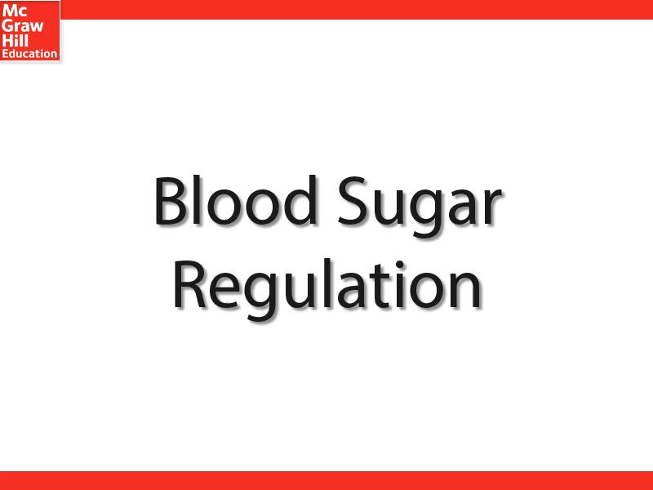

Slide 23
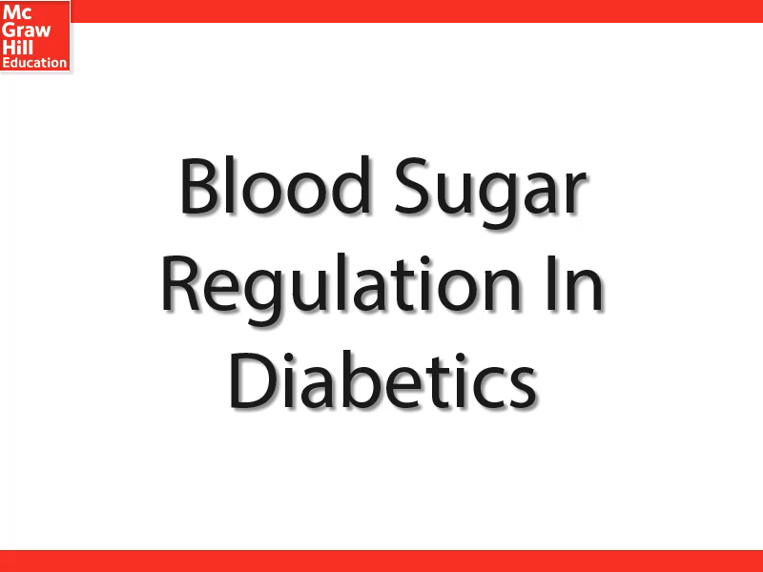

Slide 24
INSULIN
Insulin is a hormone made by and released from the pancreas (beta cells):
Helps glucose enter most cells
Enhances production and storage of:
Fat
Glycogen
Protein
Decreases hunger

Slide 25
WHAT HAPPENS WHEN YOU DON’T EAT?
When blood glucose decreases, the pancreas releases glucagon, a hormone that is made by alpha cells.
Glucagon stimulates:
Glycogenolysis
Glycogen breakdown-- releasing glucose into the blood
Lypolysis
Breakdown of triglycerides (fat) for energy

Slide 26
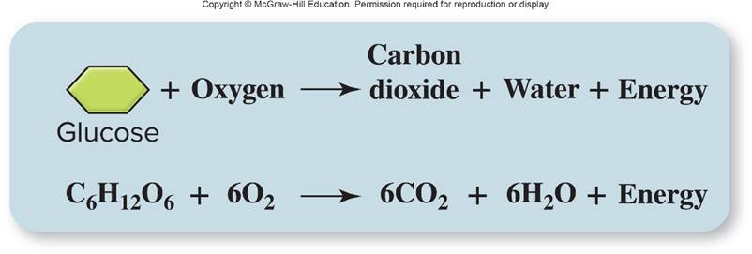
GLUCOSE FOR ENERGY
Cells use oxygen to release energy stored in glucose’s chemical bonds
Carbon dioxide and water are formed in the process
Energy is released

Slide 27
KETONE BODIES AND KETOACIDOSIS
Ketone bodies
Form as a result of incomplete fat breakdown
Fasting or starving
Low-carbohydrate, high-protein diet (e.g., Atkins diet)
Can be used by certain cells for energy
Ketoacidosis
Condition that occurs with very high blood ketone bodies
pH of blood becomes acidic.
Poorly controlled type-1 diabetes
Unconsciousness and death may occur

Slide 28
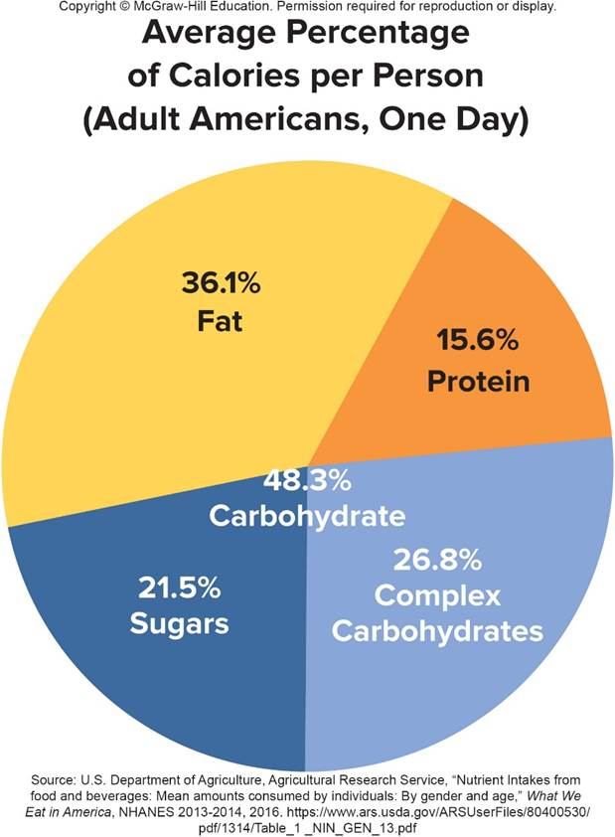
CARBOHYDRATE CONSUMPTION PATTERNS
In 2015, average American diet supplied:
approximately 18% of total kcal (approximately 22 tsp) from added (refined) sugars
According to MyPlate, added sugars are empty calories.

Slide 29
REDUCING YOUR INTAKE OF REFINED CARBOHYDRATES
Sources of Refined Carbohydrates | Substitutes
Sugar-sweetened soft drinks 🡢 | Plain water
Cookies 🡢 | Whole grains and nuts
Candy 🡢 | Fresh fruit
Chips 🡢 | Raw vegetables

Slide 30
TIPS FOR REDUCING ADDED SUGAR INTAKES
Substitute:
Fresh fruit, raw vegetables, or unsalted nuts and seeds for sweet or salty snacks;
Unsweetened yogurt or yogurt with bits of fresh fruit and/or chopped nuts for sweetened yogurts; and
Plain water or with water that has lemon or lime juice added to it for soft drinks.

Slide 31
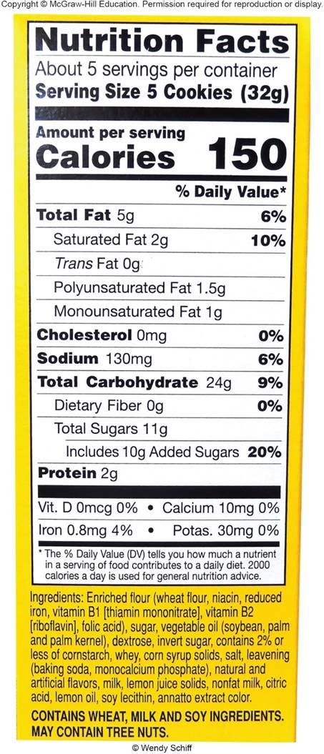
NUTRITION FACTS PANELS
The original Nutrition Facts panel has information about total carbohydrate, sugar, and dietary fiber contents in a serving of food
The new Nutrition Facts panel, which is shown here, includes information about added sugars content

Slide 32
ARE CARBOHYDRATES FATTENING?
Possibly, likely to depend on the type and amount of carbohydrate
Foods that contain high amounts of refined carbohydrates (added sugars, including high-fructose corn syrup, and refined starches)
Do not satisfy hunger as much as fatty foods or protein-rich foods
Popular snack foods often combine refined carbohydrates with fats, making them very tasty.

Slide 33
Metabolic factors
Excess carbohydrates are more likely to be burned for energy than fat, so the “carbs” spare stored body fat.
Dietary factors
Americans consume more food energy than they need.

Slide 34
SUGAR-SWEETENED BEVERAGES
Added sugar consumption associated with body weight:
Sugar-sweetened foods
Sugar-sweetened soft drinks are one of the major sources of added sugars in American diets.
Risks of obesity, type 2 diabetes, heart disease, and stroke are associated with sugar-sweetened soft drink consumption.

Slide 35
NONALCOHOLIC FATTY LIVER DISEASE (NAFLD)
Fat builds up in liver cells, causing inflammation that damages or destroys the cells.
Cirrhosis of the liver:
Can lead to liver failure and need for liver transplant
Obese people and people with diabetes are at risk of NAFLD
Prevention/treatment:
Losing excess weight,
Eating a healthy diet, and
Avoiding alcohol.

Slide 36
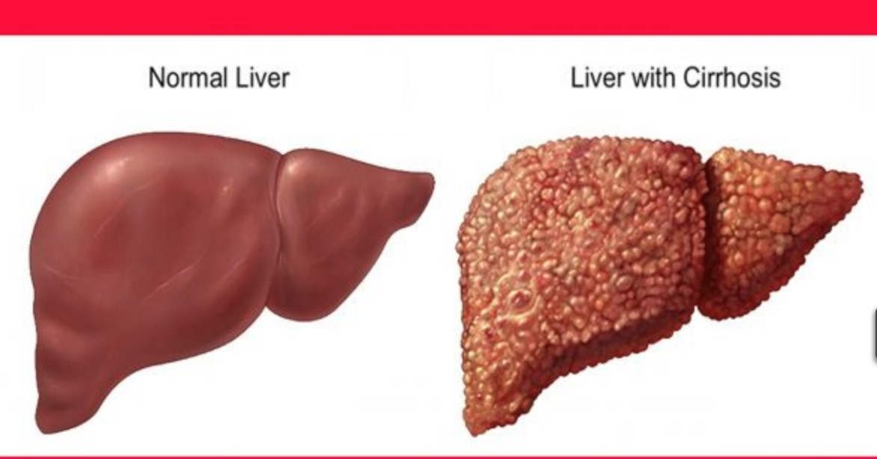

Slide 37
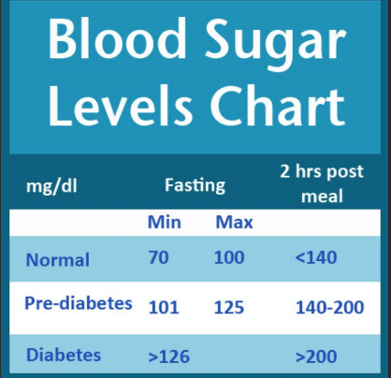
WHAT IS DIABETES?
Diabetes mellitus (“diabetes”): Group of serious chronic diseases characterized by abnormal glucose, fat, and protein metabolism
Primary sign is hyperglycemia.
Two major types
Type 1 diabetes
Autoimmune disease
Beta cells stop making insulin
Source of insulin (usually injections) is required.
Type 2 diabetes
Most common type
Insulin resistant cells

Slide 38
RISK FACTORS FOR DIABETES1
Type 1 diabetes:
Autoimmune disease, so genetic susceptibility and environmental factors may cause immune system to malfunction and destroy beta cells
No way to prevent type 1

Slide 39
RISK FACTORS FOR TYPE 2
Sedentary lifestyles
Excess body fat
Close, genetically-related family member with the disease
Hispanic, Native American, Asian, African, or Pacific Islander ancestry

Slide 40
DIABETES DURING PREGNANCY
Poorly-controlled diabetes can cause serious damage to both the pregnant woman and her fetus.
Pregnant women with diabetes have increased risk of:
Severe hypertension
Miscarriage
Premature birth
Stillbirth
Baby with birth defects
Too large newborn that has difficulty controlling its blood glucose

Slide 41

Gestational diabetes develops during pregnancy.
Usually develops after the 5th month of pregnancy
High risk pregnant women
Have family history of type 2 diabetes
Are overweight
Have high blood pressure

Slide 42
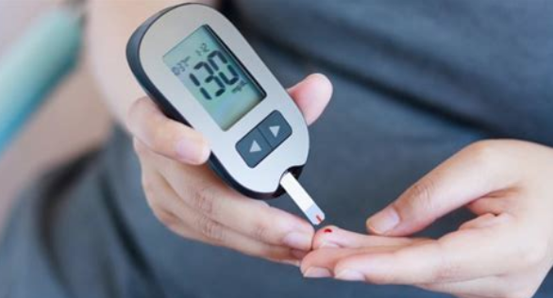
CONTROLLING DIABETES
Goal is maintenance of normal or near normal blood glucose levels.
Daily self-testing of blood glucose
Following a special diet, usually involves counting grams of carbohydrates.
Losing some excess body weight (fat)
Obtaining regular physical activity

Slide 43

CAN DIABETES BE PREVENTED?

Slide 44
WHAT IS HYPOGLYCEMIA?
Hypoglycemia
Abnormally low blood glucose levels
Fasting blood glucose: < 70 mg/dl
Blood glucose level is too low to provide cells with adequate energy.
Seizures, loss of consciousness, and death can occur
People with diabetes are at risk
Having too much insulin in bloodstream increases the risk.
Treatment involves ingestion of a source of sugar (15 grams).

Slide 45
LACTOSE INTOLERANCE
Inability to digest lactose because of inadequate lactase
Common condition, particularly in people of African, Asian, or Eastern European descent
Bacteria in the large intestine break down undigested lactose, resulting in:
Intestinal cramps, bloating, gas, and diarrhea

Slide 46
Treatment generally involves:
Avoiding lactose
Using dairy foods that have little or no lactose or have been pretreated with lactase
Some people can consume small amounts of foods that contain lactose
Note: Lactose intolerance is not the same as milk allergy

Slide 47

DOES SUGAR CAUSE HYPERACTIVITY?
Despite popular belief:
Results of scientific studies do not indicate that eating sugar or sugary foods increases children’s physical activity level, causes ADHD, or has other negative behavioral effects

Slide 48
Fiber and Colorectal Cancer:
High-fiber diets may protect against colorectal cancer.
Fiber and Heart Health:
Diets rich in fiber, particularly soluble fiber, can promote cardiovascular (heart & blood vessels) health.
Soluble fiber can reduce blood cholesterol level.
High-fiber foods generally have low energy contents

